Slide 1
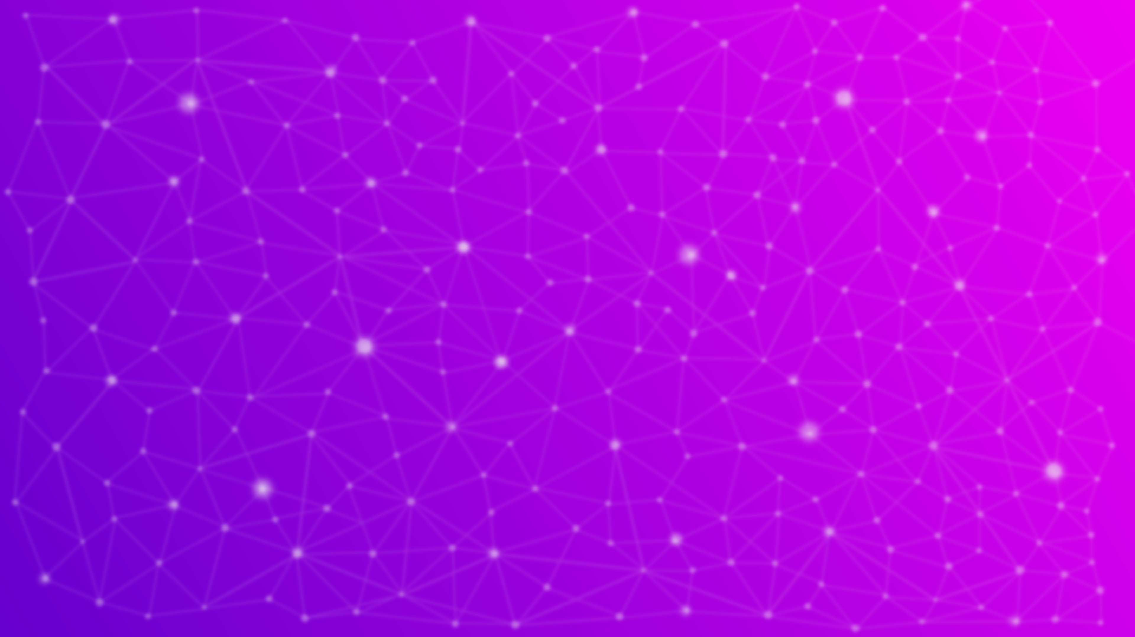
NoiseTrackr
Motivation, Use Cases, Planned Features

Slide 2


Agenda
Introduction to the Product
Use Cases
Planned Features
Prototype
Technologies Used
Architecture

Slide 3

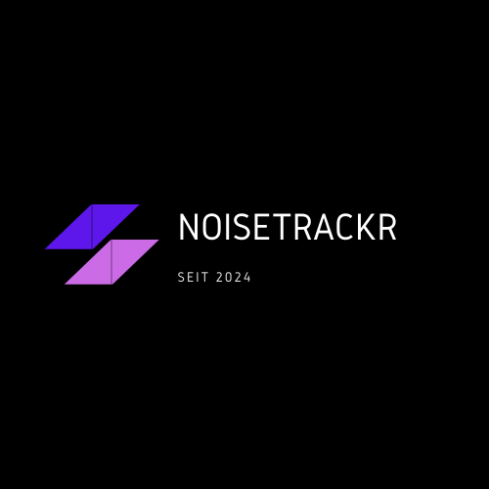

Introduction to the Product
NoiseTrackr is a web application which allows users to monitor noise at a given time and location.
Question: Why would someone want to do that?

Slide 4

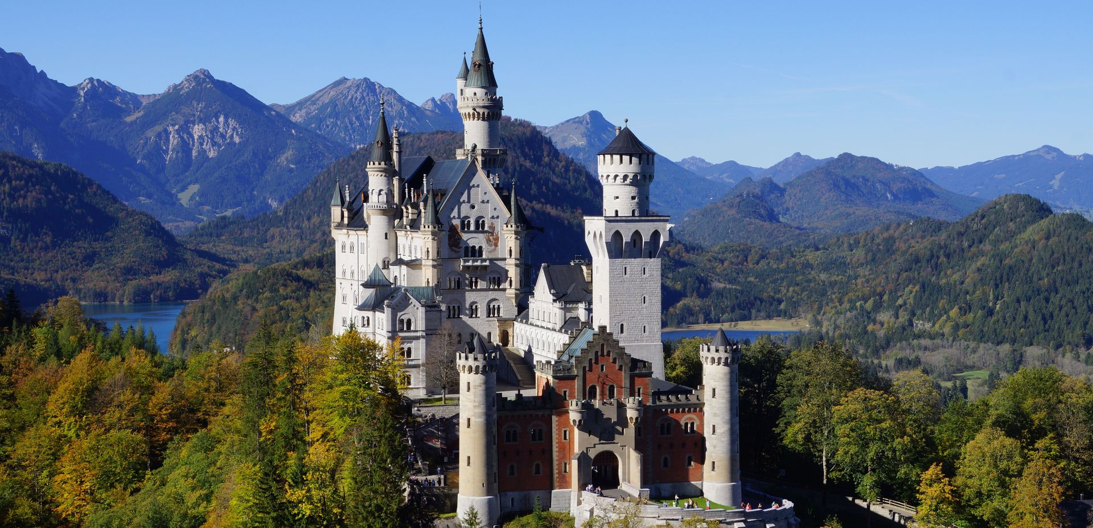
Use Case - Environmental
Touristic regions and attractions such as the Neuschwanstein Castle and Salzburg often suffer from environmental problems, such as overcrowding, soil erosion, and noise pollution;
NoiseTrackr allows municipalities to monitor these regions and discover at which areas and time periods noise pollution occurs.
↳ This in turn may be used to make tourism more sustainable!

Slide 5


Use Case - Security
Cities like Memphis, Tennessee and Rio de Janeiro, Brazil grapple with gun violence and gang activity.
NoiseTrackr can be a valuable tool for authorities, enabling them to pinpoint the location of gunshots and potentially respond much faster.
↳ Tracking noise may also be a good forensics tool for crime investigations.

Slide 6

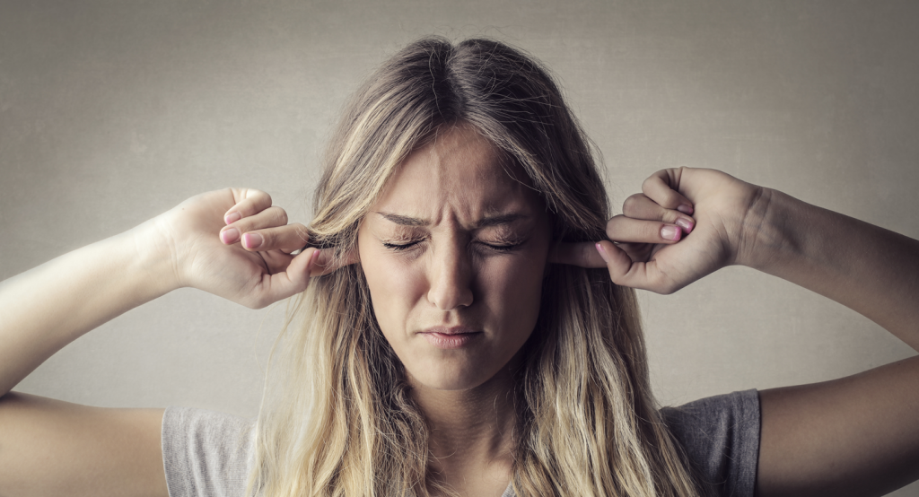
Use Case - Civil
Unwanted nighttime noise plagues apartment buildings and student dorms. From loud parties to booming music, these disturbances disrupt sleep and serenity for many residents.
NoiseTrackr empowers residents and property managers to pinpoint the exact source of noise disturbances, whether it's a specific apartment, building block, or house.

Slide 7
Planned Features (Minimum Viable Product)
Decomposed, this is the utilities of NoiseTrackr:
Gather and store noise data and their locations;
Display spacio-temporal noise data with the use of:
↳ Heatmaps;
↳ Time-Series graphs;
↳ Noise levels visualizers.
Predict the amount of noise in the next hour for a given region.
NoiseTrackr should offer customizable monitoring. Users can select specific areas and timeframes to analyze, tailoring the data to their needs.

Slide 8
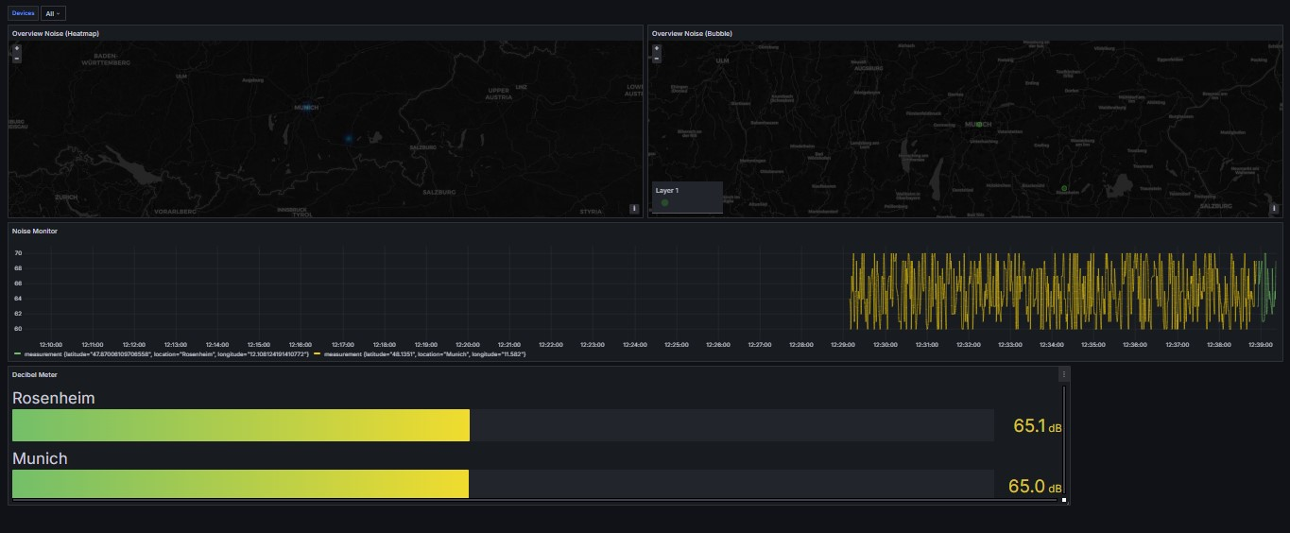
Prototype of NoiseTrackr

Slide 9






Technologies Used
Database System: InfluxDB (optimal for time-series data)
REST API: FastAPI (for instantiating the model and sending it to Grafana)
Machine Learning: Sklearn
Web Application: Grafana for fetching and allowing the visualization of data
Devices: Raspberry Pi + Noise Sensors
Connection Related: LoRa protocol, MQTT, and MQTT broker

Slide 10

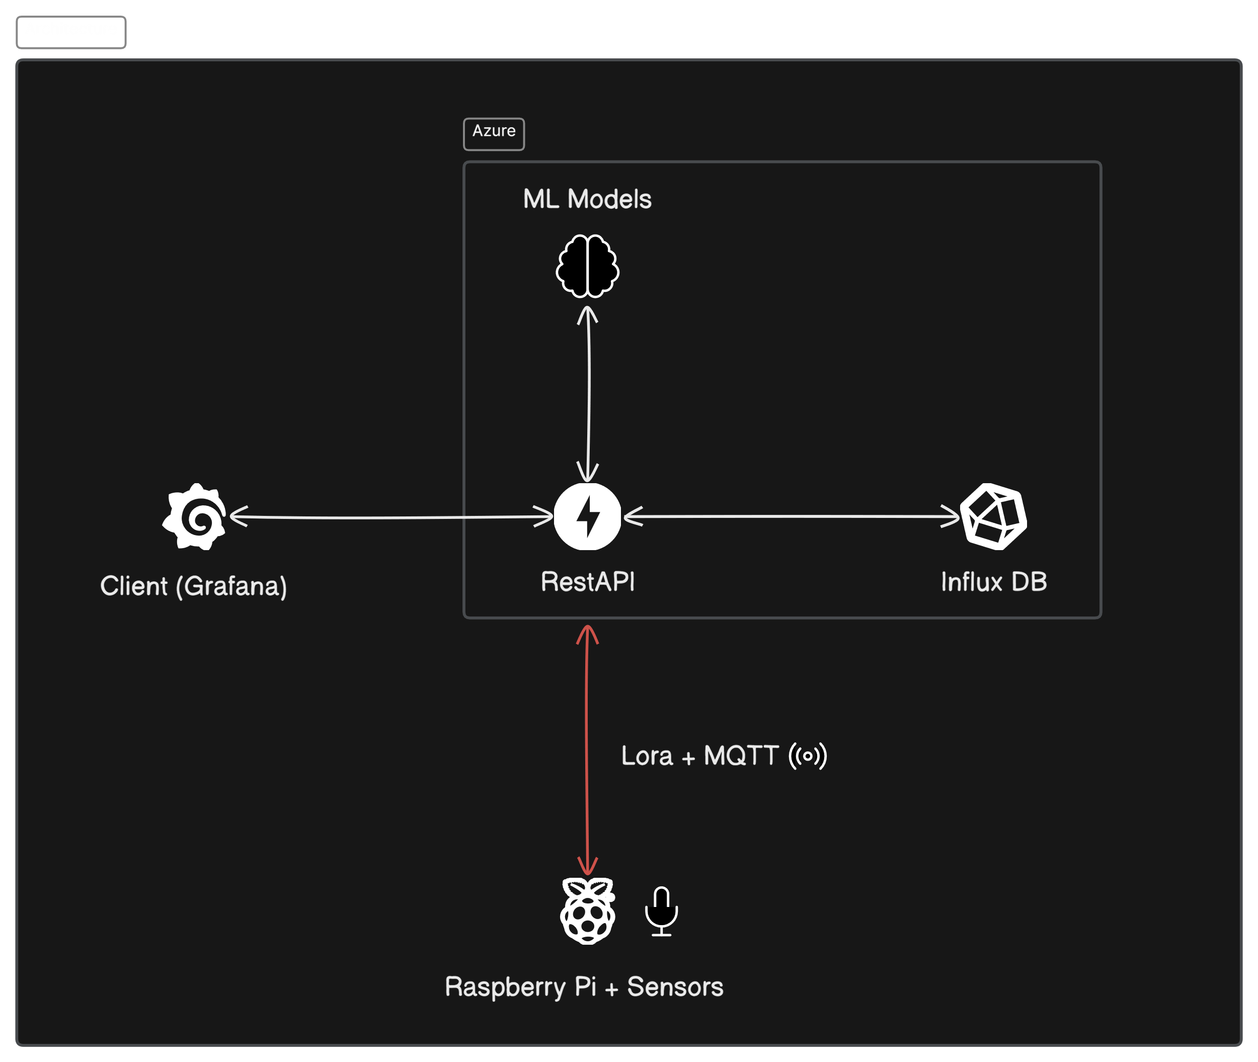
Architecture (for now!)

Slide 11
Thank You!
Question Time

